Slide 1

Mini Project Analysis of Movie Review
Group – 1
Achal Hemal Doshi
Praneeth Kumar
Laxmikanth Borado
Venkatesh Korakullu
P Manikanta Manohar

Slide 2
Index
Abstract
3
Introduction
4
Objective
5
20
Data and Data Cleaning
6
Exploratory Data Analysis
7, 8, 9, 10, 11, 12
Machine Learning Algorithm
13, 14, 15, 16, 17
Conclusion
18
Appendix

Slide 3
Abstract
This study explores analysis techniques applied to movie reviews.
It discusses the importance of analysis in the film industry, reviews various analysis techniques, and explores the challenges associated with analysis of movie reviews.
The study also investigates the applications of analysis in the film industry, presenting case studies and examples to illustrate how analysis insights can be utilized.
The overall goal is to gain a deeper understanding of audience sentiments to improve decision-making and enhance audience satisfaction.

Slide 4
Introduction
The project is aimed at analyzing movie reviews from IMDb and BookMyShow to understand the sentiment of the audience towards films and identify patterns of positivity, negativity, and neutrality across genres.
The objective is to explore the potential correlation between review sentiments and box office success and investigate if positive reviews are connected to higher revenue and audience engagement.
By using machine learning algorithms, data visualization, and predictive modeling, the project aims to uncover insights beyond individual opinions, revealing broader trends within the movie-watching community.
Ultimately, this analysis provides actionable insights for decision-making in the film industry.

Slide 5
Objective
The objective of the mini project on the analysis of movie reviews is to utilize machine learning techniques to categorize reviews into positive, negative, and neutral sentiments.

Slide 6
Data and Data Cleaning
Data Introduction:
The data consists of 11 columns and 100 observations.
Attributes:
Variable Name | Description
Review Type | Dependent Variable stores the type of review, i.e., 0 (Negative), 1 (Neutral), 2 (Positive).
Movie Budget (INR) | It stores the budget of the movie selected by us.
Movie Release Date | It stores the release date of the movie selected by us.
Movie Genre | It stores the genre of the movie, i.e., 0 (Action), 1 (Comedy), 2 (Horror), 3 (Romance), 4 (Sci-Fi)
Movie Name | It stores the name of the movie, i.e., 0 (Dream Girl 2), 1 (Hi Nanna), 2 (Salaar: Part 1 – Ceasefire), 3 (The Creator), 4 (The Exorcist: Believer)
Movie Rating | It stores the rating of the movie given by the public
Review | It stores the review given by the user
Review Date | It stores the date of the review given by the user
Review Rating | It stores the rating given by the user when giving the review
Review Source | It stores the source from which the review is collected, i.e., 0 (BookMyShow), 1 (IMDb)

Slide 7
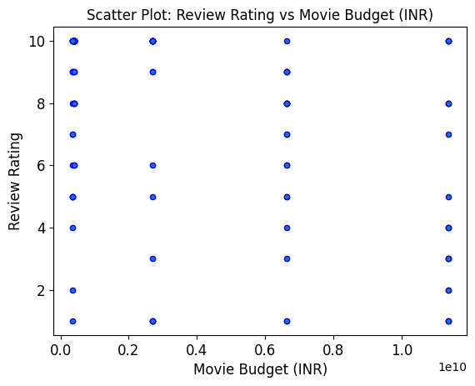
Scatter Plot of Review Rating and Movie Budget (INR)
Exploratory Data Analysis
Movie Budget (INR) has a negative correlation with Review Rating, i.e., Movie Budget (INR) has a decreasing trend with Review Rating, i.e., as Movie Budget (INR) decreases Review Rating also decreases.

Slide 8
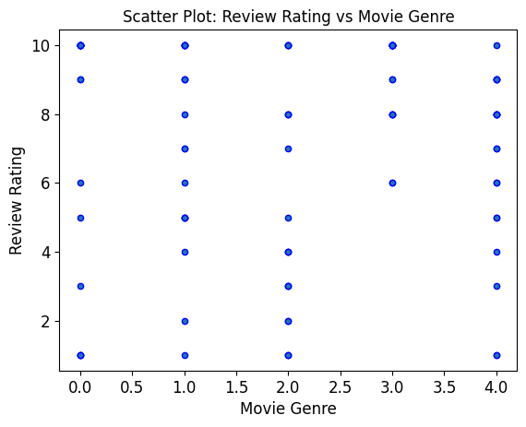
Scatter Plot of Review Rating and Movie Genre
Exploratory Data Analysis
Movie Genre has a negative correlation with Review Rating, i.e., Movie Genre has a decreasing trend with Review Rating, i.e., as Movie Genre decreases Review Rating also decreases.

Slide 9
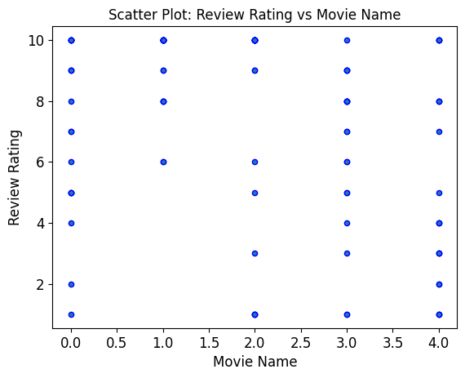
Scatter Plot of Review Rating and Movie Name
Exploratory Data Analysis
Movie Name has a negative correlation with Review Rating, i.e., Movie Name has a decreasing trend with Review Rating, i.e., as Movie Name decreases Review Rating also decreases.

Slide 10
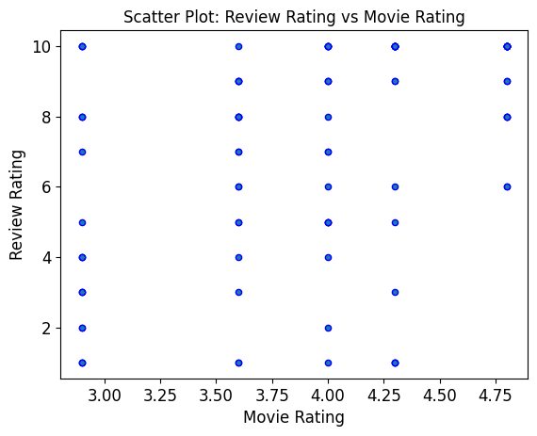
Scatter Plot of Review Rating and Movie Rating
Exploratory Data Analysis
Movie Rating has a negative correlation with Review Rating, i.e., Movie Rating has a decreasing trend with Review Rating, i.e., as Movie Rating decreases Review Rating also decreases.

Slide 11
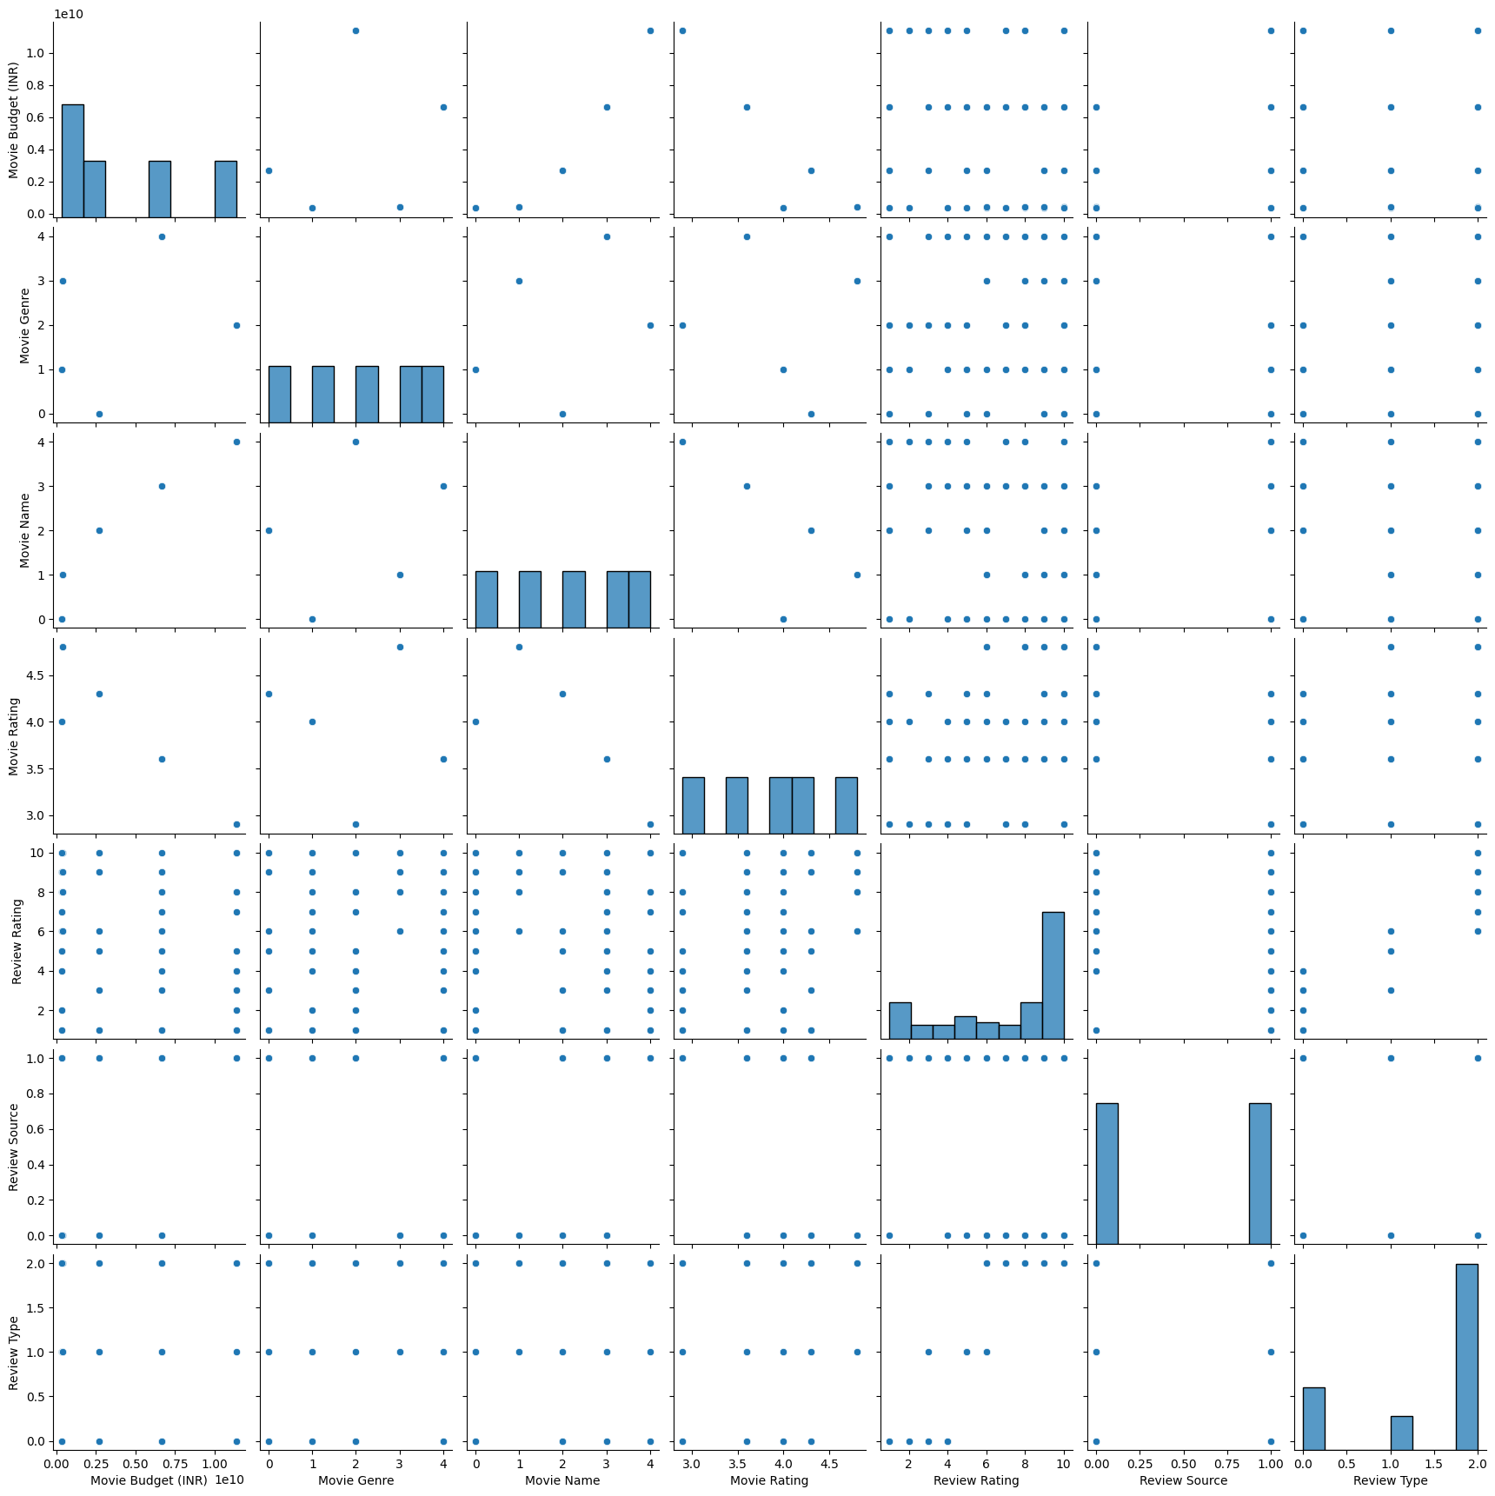
Pair Plot
Exploratory Data Analysis
Movie Genre, Movie Rating, and Review Rating all variables are positively correlated with the target variable (Review Type). Movie Budget (INR), Movie Name, and Review Source all variables are negatively correlated with the target variable (Review Type).

Slide 12
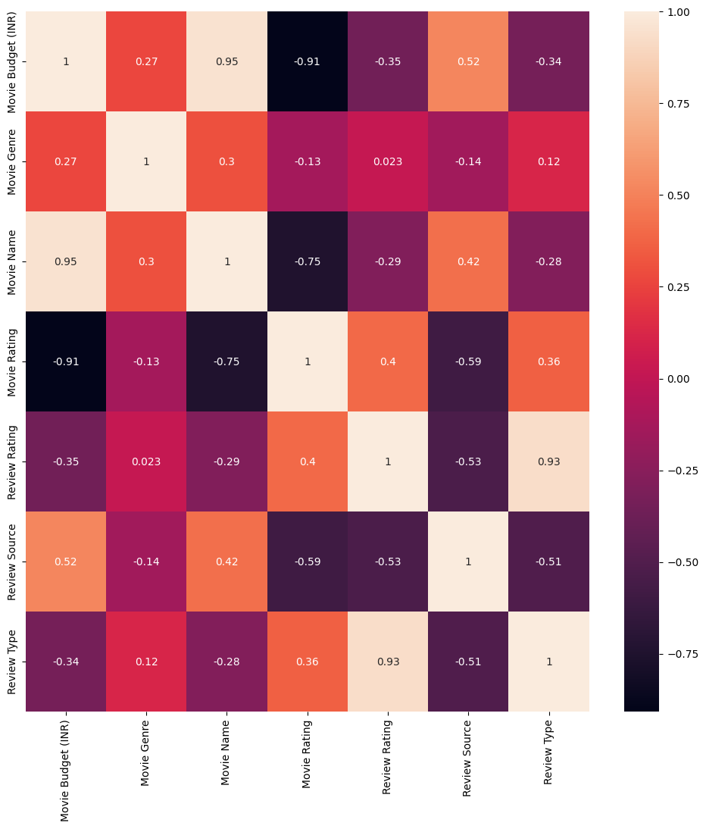
Heat Map
Exploratory Data Analysis
Strong Correlation: Movie Budget (INR) and Movie Name, Movie Budget (INR) and Movie Rating. and Review Rating and Review Type. Moderate Correlation: Movie Budget (INR) and Review Source, Movie Name and Movie Rating, Movie Rating and Review Source, Review Rating and Review Source, and Review Source and Review Type. The rest not stated have a weak correlation.

Slide 13
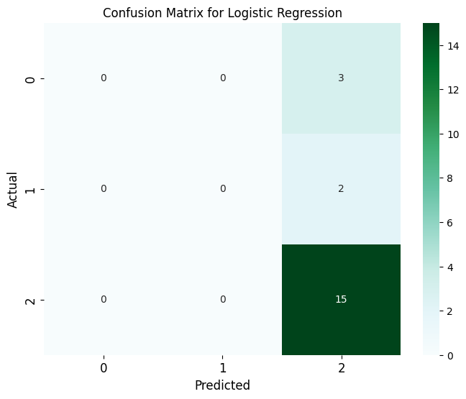
Machine Learning Algorithms
Logistic Regression:
Train Test Ratio | Review Type | Precision | Recall | F1 - Score | C | Accuracy
65 - 35 | 0 (Negative) | 0 | 0 | 0 | 0.001 | 65.71%
 | 1 (Neutral) | 0 | 0 | 0
 | 2 (Positive) | 0.66 | 1 | 0.79
70 - 30 | 0 (Negative) | 0 | 0 | 0 | 0.001 | 66.67%
 | 1 (Neutral) | 0 | 0 | 0
 | 2 (Positive) | 0.67 | 1 | 0.8
75 - 25 | 0 (Negative) | 0 | 0 | 0 | 0.001 | 72%
 | 1 (Neutral) | 0 | 0 | 0
 | 2 (Positive) | 0.72 | 1 | 0.84
80 - 20 | 0 (Negative) | 0 | 0 | 0 | 0.001 | 75%
 | 1 (Neutral) | 0 | 0 | 0
 | 2 (Positive) | 0.75 | 1 | 0.86

Slide 14
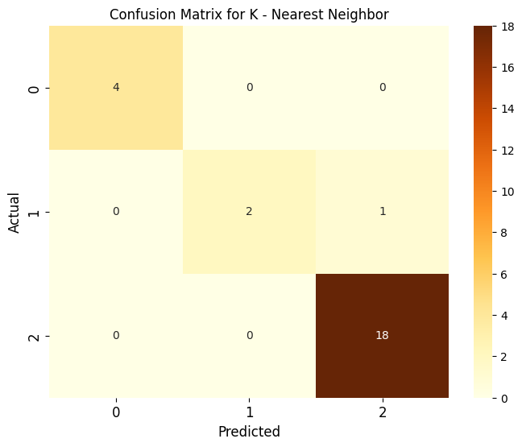
Machine Learning Algorithms
K – Nearest Neighbors:
Train Test Ratio | Review Type | Precision | Recall | F1 - Score | K | Accuracy
65 - 35 | 0 (Negative) | 0.5 | 0.75 | 0.6 | 1 | 88.57%
 | 1 (Neutral) | 0.83 | 0.62 | 0.71
 | 2 (Positive) | 1 | 1 | 1
70 - 30 | 0 (Negative) | 0.6 | 0.75 | 0.67 | 1 | 86.67%
 | 1 (Neutral) | 0.75 | 0.5 | 0.6
 | 2 (Positive) | 0.95 | 1 | 0.98
75 - 25 | 0 (Negative) | 1 | 0.75 | 0.86 | 1 | 96%
 | 1 (Neutral) | 0.75 | 1 | 0.86
 | 2 (Positive) | 1 | 1 | 1
80 - 20 | 0 (Negative) | 1 | 1 | 1 | 1 | 95%
 | 1 (Neutral) | 1 | 0.5 | 0.67
 | 2 (Positive) | 0.94 | 1 | 0.97

Slide 15
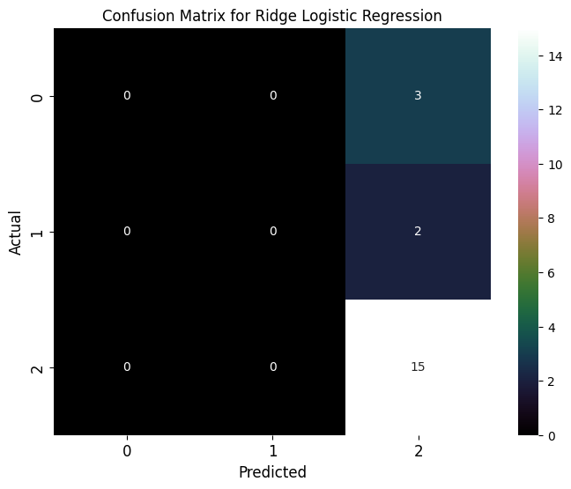
Machine Learning Algorithms
Ridge Logistic Regression:
Train Test Ratio | Review Type | Precision | Recall | F1 - Score | C | Accuracy
65 - 35 | 0 (Negative) | 0 | 0 | 0 | 0.001 | 65.71%
 | 1 (Neutral) | 0 | 0 | 0
 | 2 (Positive) | 0.66 | 1 | 0.97
70 - 30 | 0 (Negative) | 0 | 0 | 0 | 0.001 | 66.67%
 | 1 (Neutral) | 0 | 0 | 0
 | 2 (Positive) | 0.67 | 1 | 0.8
75 - 25 | 0 (Negative) | 0 | 0 | 0 | 0.001 | 72%
 | 1 (Neutral) | 0 | 0 | 0
 | 2 (Positive) | 0.72 | 1 | 0.84
80 - 20 | 0 (Negative) | 0 | 0 | 0 | 0.001 | 75%
 | 1 (Neutral) | 0 | 0 | 0
 | 2 (Positive) | 0.75 | 1 | 0.86

Slide 16
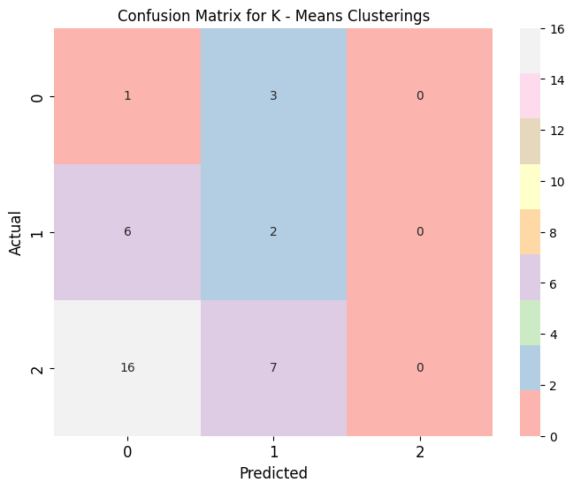
Machine Learning Algorithms
K-Means Clustering:
Train Test Ratio | Review Type | Precision | Recall | F1 - Score | K | Accuracy
65 - 35 | 0 (Negative) | 0.25 | 0.75 | 0.38 | 2 | 25.71%
 | 1 (Neutral) | 0.26 | 0.75 | 0.39
 | 2 (Positive) | 0 | 0 | 0
70 - 30 | 0 (Negative) | 0.05 | 0.25 | 0.09 | 2 | 6.67%
 | 1 (Neutral) | 0.09 | 0.17 | 0.12
 | 2 (Positive) | 0 | 0 | 0
75 - 25 | 0 (Negative) | 0.07 | 0.25 | 0.11 | 2 | 8%
 | 1 (Neutral) | 0.09 | 0.33 | 0.14
 | 2 (Positive) | 0 | 0 | 0
80 - 20 | 0 (Negative) | 0.09 | 0.33 | 0.14 | 2 | 10%
 | 1 (Neutral) | 0.11 | 0.55 | 0.18
 | 2 (Positive) | 0 | 0 | 0

Slide 17
Machine Learning Algorithms
Model Evaluations:
Model | Accuracy
Logistic Regression | 75%
K - Nearest Neighbor | 96%
Ridge Logistic Regression | 75%
K - Means Clustering | 25.71%

Slide 18
Conclusion
Four Machine Learning Algorithms were used for the analysis of the movie review dataset: Logistic Regression, K - Nearest Neighbors, Ridge Logistic Regression, and K - Means Clustering.
After conducting various analyses and implementing different algorithms, we discovered that K - Nearest Neighbor yielded the best results.
Specifically, when using a 75 - 25 train-test ratio, we obtained an accuracy of 96% which is the highest accuracy value compared to all the other accuracy we encountered.
Our analysis of IMDb and BookMyShow reviews revealed that audience satisfaction and enjoyment are critical factors in the success of movies.
Positive sentiment was predominant among viewers, with certain factors like acting performance, storyline coherence, and visual effects being key determinants.
Trends and genre preferences also offer opportunities for targeted content creation and marketing strategies.
However, the reliance on online reviews introduces biases, and further research is needed on demographic factors and cultural influences.
Overall, our analysis offers practical insights for improving the movie-watching experience and fostering audience engagement.
The confusion matrix of the K-Nearest Neighbors is [[ 3 0 0 ]
[ 0 1 1 ]
[ 0 0 15 ]]

Slide 19


Thank you
Group – 1
Achal Hemal Doshi
Praneeth Kumar
Laxmikanth Borado
Venkatesh Korakullu
P Manikanta Manohar

Slide 20
Appendix

Slide 21
Train and Test Splitting

Slide 22
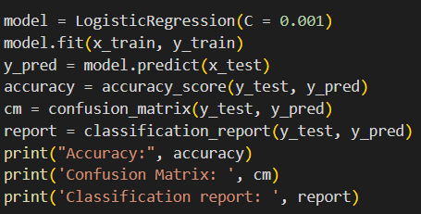
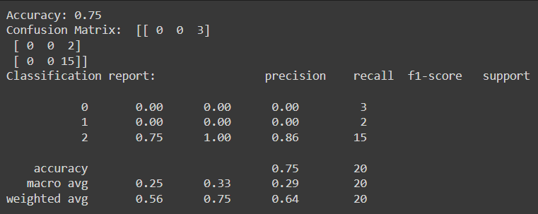
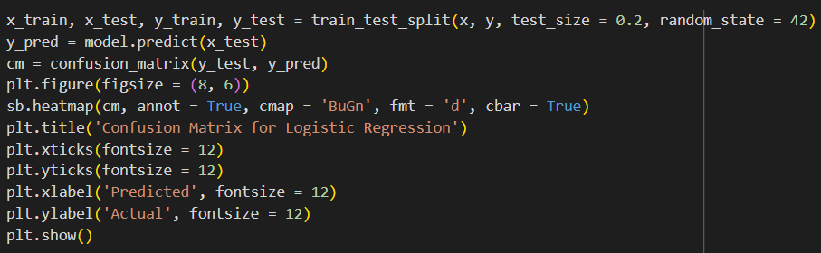
Logistic Regression

Slide 23
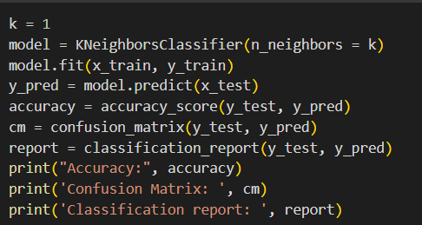
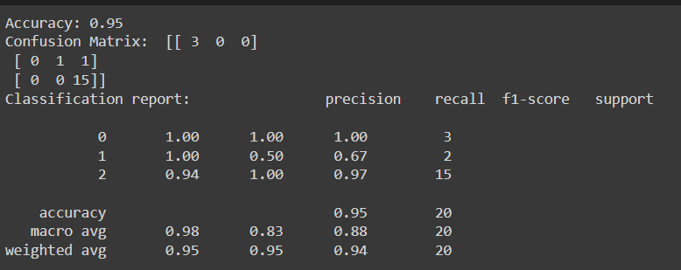
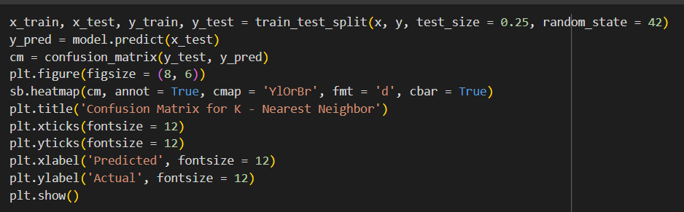
K-Nearest Neighbors

Slide 24
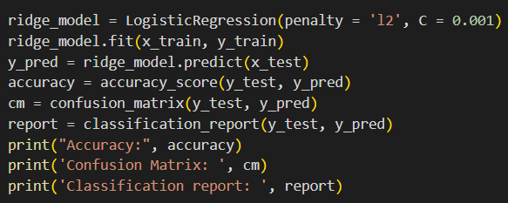
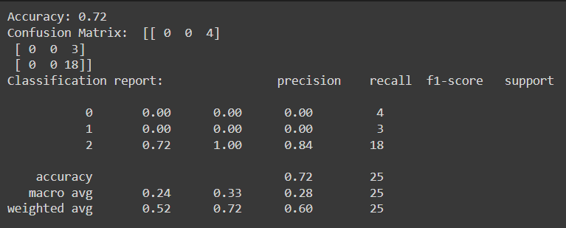
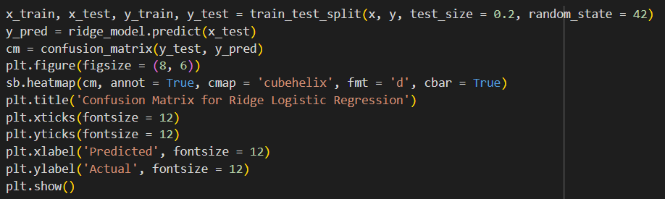
Ridge Logistic Regression

Slide 25
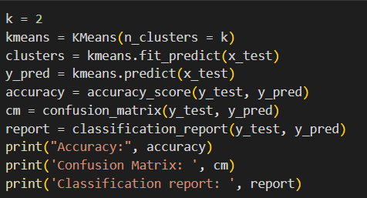
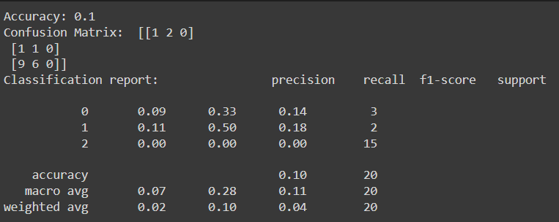
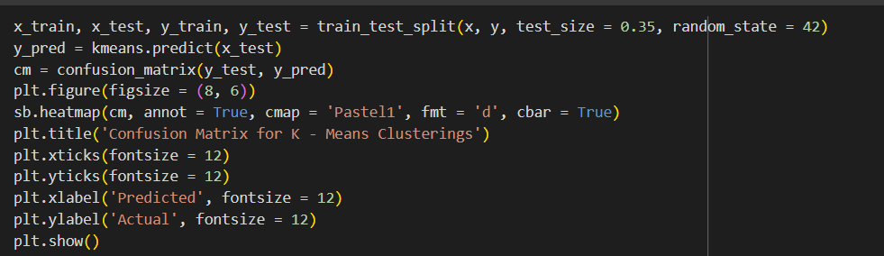
K-Means Clustering

